Slide 1
Concord NC
Name
Date

Slide 2
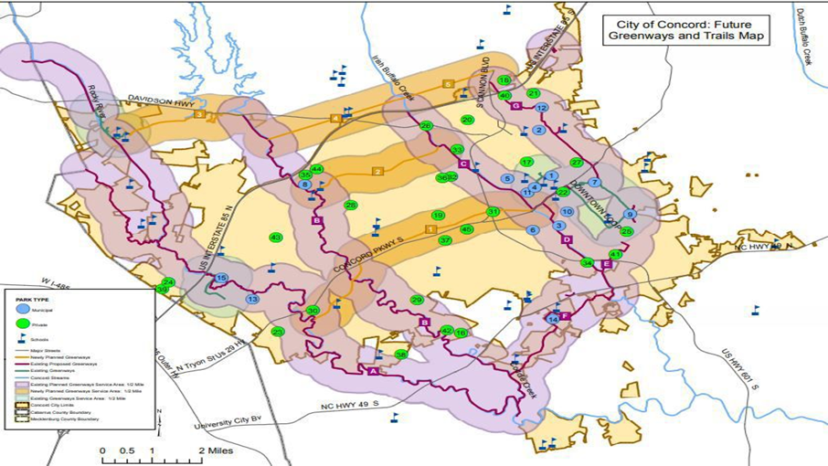
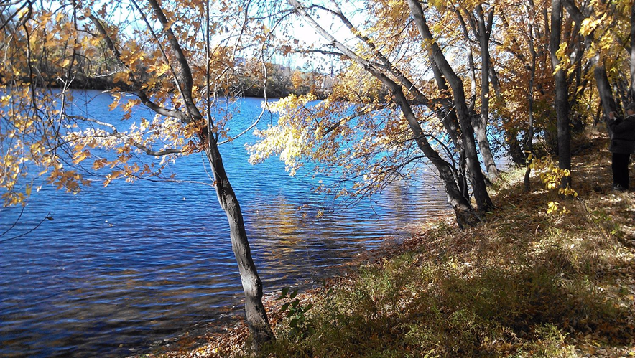
Site Overview
Conservation lands within the major river drainages.
The area is predominantly flanked rustic establishments.
Many of portions of the area lack water and sewer service.
Storm water runoff that erode soil; areas cleared for development.
Notes:
Photograph shows Merrimack River Drainage sub watershed while the green spots in the map alludes to the areas in the city for earmarked for conservation projects.

Slide 3
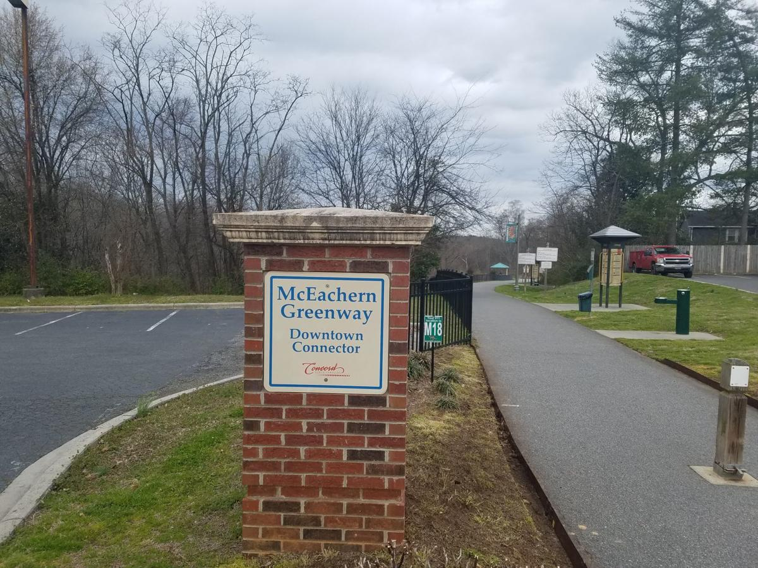
Soil and Geotechnical Conservation
Conservation administered by the Cabarrus Soil and Water Conservation District.
Facilitates responsible use of the land and all its natural resources.
A board of supervisors convene monthly to discuss local soil and water conservation priorities.
Notes:
McEachern Greenway is one of the area in Concord whose architecture has been developed to reduce surface runoff and facilitate soil conservation.

Slide 4
Project Phasing
The city has installed plans to conserve land and its natural resources.
The areas that are largely unprotected and undeveloped have been earmarked for conservation.
The selection criteria for development areas take into consideration the physical diversity.
Notes:
Physical diversity entails the variety of geological and hydrological features. There are also considerations on the area’s potency to provide essential services such as drinking water, food products, flood control, and timber products.

Slide 5
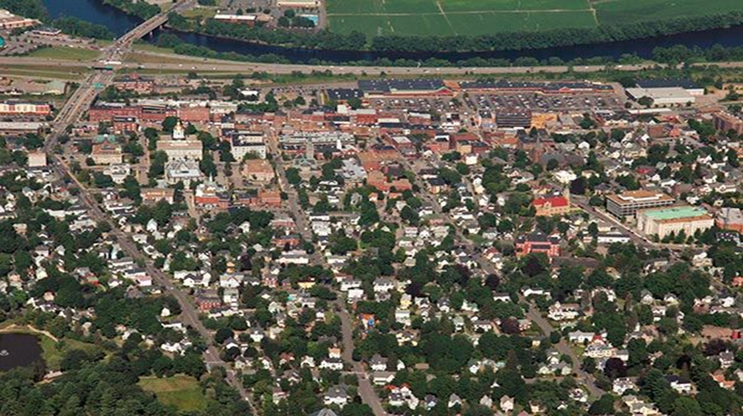
Open Space
Two categories of open space: the undeveloped land and the recreation areas
Among its open spaces for conservation include land trust properties, state parks and forests, as well as areas protected by conservation easements.
Notes:
Photograph depicts trails in the open spaces of Concord city that ease the movement of people and allow for water movement into drainage systems during rainfall.

Slide 6
References
City of Concord. (2017, June). Conservation and Open Space Plan. Retrieved from http://www.arcgis.com/apps/MapJournal/index.html?appid=413f41065dc34f4a874525140e20d57e
Thompson, A. (2020). Concord making push to connect city through greenways, multi-use paths. Independent Tribune. Retrieved from https://independenttribune.com/cit/concord-making-push-to-connect-city-through-greenways-multi-use-paths/article_d7faa9fc-9246-50da-8058-0522a089ee3e.html

